Slide 1
Silicon Valley Rent Segmentation
Priam Fernandes

Slide 2
Business Problem
The Silicon Valley is a technological hub that employs millions of highly skilled workers
With the large size of the Bay Area, it is overwhelming to find a place to live that is affordable as well as near various amenities
This study is used to cluster the Santa Clara county based on various venues and segment the clusters based on median rent for a two-bedroom apartment in each zip code of the county

Slide 3
Data Requirement and Collection
A list of zip codes within the Santa Clara County
I was able to scrap data from Santa Clara County Public Health website: https://www.sccgov.org/sites/phd/hi/hd/Pages/city-profiles.aspx. This provided a list of cities and neighborhoods within Santa Clara County along with zip codes.
2. Median rent for Santa Clara County by Zip code
This data was scrapped from a real estate search website: https://www.zillow.com/santa-clara-county-ca/home-values/. This website provides the most up to date data on housing prices and rents. I was able to scrap the data for 2019 median rent for each zip code in the county.
3. Geo Locator for geographical coordinates of the county
Importing Geocoder library to get the coordinates for Santa Clara County
4. List of venues in each neighborhood
A list of venues in each neighborhood will be pulled from Foursquare API
5. Map generation
Using Folium to generate maps in Python.

Slide 4
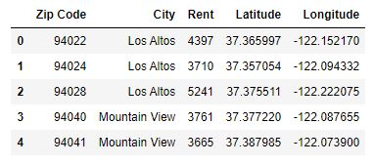
Preparing the Dataset

Slide 5
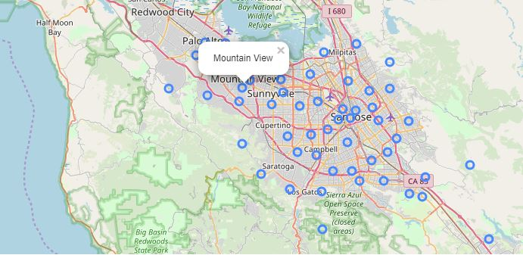
Using Folium to plot zip codes on map

Slide 6
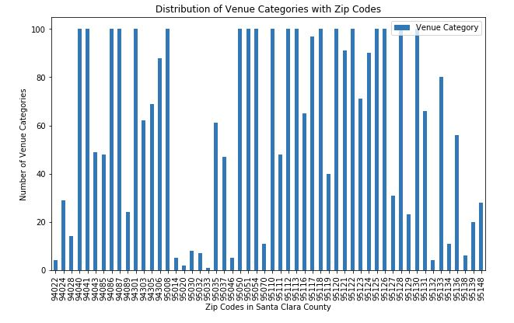
Using Foursquare API to obtain venues

Slide 7
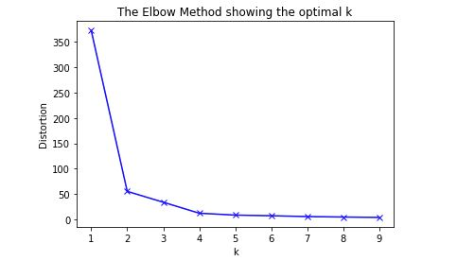
K-Means Clustering
Optimal K=2
Used K=4 (to increase number of cluster)

Slide 8
Clustering and Segmenting
Cluster Number | Cluster Label
Cluster 0 | Restaurants, Coffee Shops and Stores
Cluster 1 | Parks, Grocery Stores, Eateries
Cluster 2 | Hotels and Social Venues
Cluster 4 | Parks, Hills, Restaurants
Rent Level | Rent Level
Low | $2,556 - $3,451
Average | $3,452 - $4,346
High | $4,346 - $5,241

Slide 9
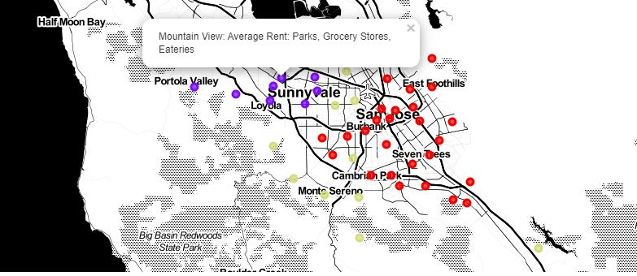
Plotting Clusters on Map

Slide 10
Conclusion and future direction
The model using zip code is a good starting point on clustering the neighborhood and identifying affordability
Further work can be done at a more granular level and expanded to the entire Bay Area
The study can also be used to help first time home buyers in locating neighborhood and affordability

